Slide 1
Generalized Linear Models
NRES 776
Instructor: Heather Bryan
Oct 28, 2021

Slide 2
Learning Objectives
Define generalized linear models (GLMs)
Describe the three components of GLMs
Describe two important assumptions of GLMs
Use Binomial and Poisson GLMs
Check the fit of Binomial and Poisson GLMs to data

Slide 3

General Linear Model
generalization of linear model where the response variable is a linear function of both numeric and/or categorical variables
$$y_{i}= β_{0}+β_{1}x_{i1}+β_{2}x_{i2}+⋯+β_{p}x_{ip}+ε_{i}$$
$$ε_{i} \sim Normal(0, σ^{2})$$
general: multiple numeric and/or categorical variables
linear: linear combination of parameters
Notes:
the response yi , i = 1, . . . , n is modelled by a linear function of explanatory variables xj , j = 1, . . . , p plus an error term.

Slide 4

Generalized Linear Model
generalization of general linear model which accommodates other error structures (e.g. Poisson, Binomial) in addition to Normal
Restricted range for the response
probability: 0 to 1 (Binomial)
count: $≥$ 0 (Poisson)
Variance of response depends on the mean
Binomial: $E\left(Y\right)=np$and $V\left(Y\right)=np(1−p)$
Poisson: $E\left(Y\right)=λ$and $V\left(Y\right)=λ$
Notes:
Exponential family: includes Gamma, exponential, beta

Slide 5
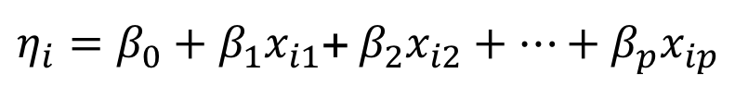


Three components of GLMs
systematic component (linear predictor)
$η_{i}=β_{0}+β_{1}x_{i1}$+ $β_{2}x_{i2}+…+β_{p}x_{ip}$
link function
$${g\left(μ_{i}\right)=η}_{i}$$
random component (variance function)
$$var\left(y_{i}\right)= φV(μ_{i})$$
dispersion parameter
Notes:
systematic component: linear function of categorical and/or numeric variables which describe the response
link function: a link function that describes how the mean (i.e., predicted value of Y), E(Yi) = µi , depends on the linear predictor
Ni is greek letter eta
random component: describes how the variance depends on the mean

Slide 6
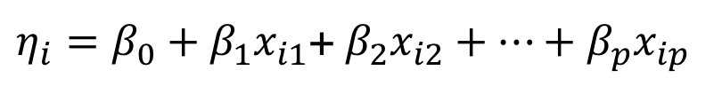



Normal GLM
$$y_{i} \sim Normal(μ_{i},σ^{2})$$
systematic component (linear predictor)
$η_{i}=β_{0}+β_{1}x_{i1}$+ $β_{2}x_{i2}+…+β_{p}x_{ip}$
link function (identity)
$${μ_{i}=η}_{i}$$
random component (variance function)
$$var\left(y_{i}\right)= σ^{2}$$

Slide 7


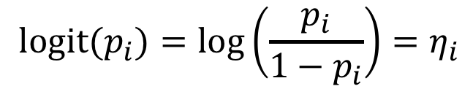


Binomial GLM
$$y_{i} \sim Binomial(n_{i},p_{i})$$
systematic component (linear predictor)
$η_{i}=β_{0}+β_{1}x_{i1}$+ $β_{2}x_{i2}+…+β_{p}x_{ip}$
link function (logit)
$${logit(p_{i})=\log\left(\frac{p_{i}}{1−p_{i}}\right)=η}_{i}$$
$$\left(0, 1\right)→\left(−∞, ∞\right)$$
random component (variance function)
$var\left(y_{i}\right)=n_{i}p_{i}(1−p_{i}$)
Notes:
Binomial is when you have proportional data (e.g., disease prevalence)

Slide 8
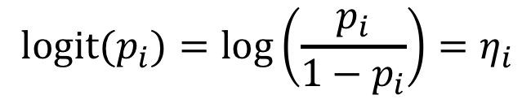
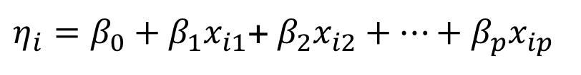


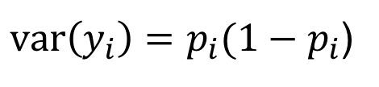
Binomial (Bernoulli) GLM
$$y_{i} \sim Binomial(1,p_{i})$$
or
$$y_{i} \sim Bernoulli(p_{i})$$
systematic component (linear predictor)
$η_{i}=β_{0}+β_{1}x_{i1}$+ $β_{2}x_{i2}+…+β_{p}x_{ip}$
link function (logit)
$${{logit(p}_{i})=\log\left(\frac{p_{i}}{1−p_{i}}\right)=η}_{i}$$
$$\left(0, 1\right)→\left(−∞, ∞\right)$$
random component (variance function)
$var\left(y_{i}\right)=p_{i}(1−p_{i}$)
Notes:
Bernoulli is a very similar, for when you have data collected as 0 or 1

Slide 9
Poisson GLM
λ = 0.1
λ = 0.1
λ = 1.0
λ = 1.0
λ = 2.0
λ = 4.0
λ = 2.0
λ = 4.0

Slide 10




Poisson GLM
$$y_{i} \sim Poisson(λ_{i})$$
systematic component (linear predictor)
$η_{i}=β_{0}+β_{1}x_{i1}$+ $β_{2}x_{i2}+…+β_{p}x_{ip}$
link function (log)
$${log(λ_{i})=η}_{i}$$
$$\left(0,∞\right)→\left(−∞, ∞\right)$$
random component (variance function)
$$var\left(y_{i}\right)=λ_{i}$$
Notes:
yi residuals are normally distributed

Slide 11
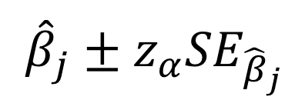

Inference: slopes
Confidence interval:
$${\hat{β}}_{j}±z_{α}{SE}_{{\hat{β}}_{j}}$$
$$z=\frac{{\hat{β}}_{j}}{{SE}_{{\hat{β}}_{j}}}$$
Hypothesis testing (z or Wald)
For large sample sizes (>100)
Hypothesis testing (log-Likelihood Ratios)
For small to moderate sample sizes
Notes:
check book for confidence interval of intercept

Slide 12

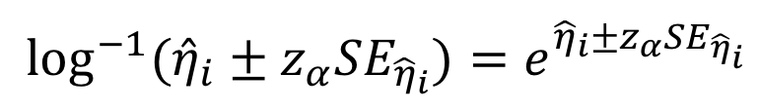
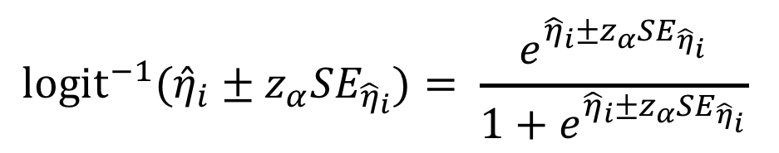
Inference: fitted values
First, compute CI on scale of linear predictor (link function)
$${\hat{η}}_{i}±z_{α}{SE}_{{\hat{η}}_{i}}$$
Second, convert CI to scale of response variable
$${{logit}^{−1}(\hat{η}}_{i}±z_{α}{SE}_{{\hat{η}}_{i}})= \frac{e^{{\hat{η}}_{i}±z_{α}{SE}_{{\hat{η}}_{i}}}}{1+e^{{\hat{η}}_{i}±z_{α}{SE}_{{\hat{η}}_{i}}}}$$
Binomial GLM
Poisson GLM
$${\log^{−1}(\hat{η}}_{i}±z_{α}{SE}_{{\hat{η}}_{i}})=e^{{\hat{η}}_{i}±z_{α}{SE}_{{\hat{η}}_{i}}}$$
Notes:
Inverse of the logit is the logistic function
Inverse of log is the exponential function

Slide 13
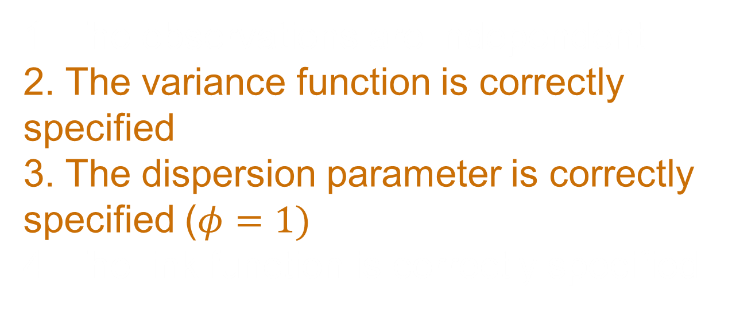
Assumptions
1. The observations are independent
2. The variance function is correctly specified
3. The dispersion parameter is correctly specified ($φ=1)$
4. The link function is correctly specified
Notes:
check book for confidence interval of intercept

Slide 14
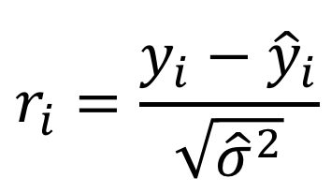




Pearson residuals and model checking
$$r_{i}=\frac{y_{i}−{\hat{y}}_{i}}{\sqrt{{\hat{σ}}^{2}}}$$
Pearson residuals are used for model checking:
Plot Pearson residuals vs fitted values: no pattern
Plot Pearson residuals vs predictors: no pattern
Compute dispersion statistic
4175 Davis Rd
4175 Davis Rd
$$\hat{φ}=\frac{\sum_{i=1}^{n}{r_{i}^{2}} }{n−p}$$
$\hat{φ}$ > 1: overdispersion
$\hat{φ}$ < 1: underdispersion
$\hat{φ}$ must be close to 1
Notes:
No assumption of normality of residuals to test for non-Normal error structures
Overdispersion: occurs when variation in the data exceeds the theoretical or expected amount of variability
Model SE will be biased small, potentially leading to Type I error
Ad hoc: multiply SE by the square root of the estimated dispersion parameter
Underdispersion: occurs when variation in the data is smaller than the theoretical or expected amount of variability

Slide 15
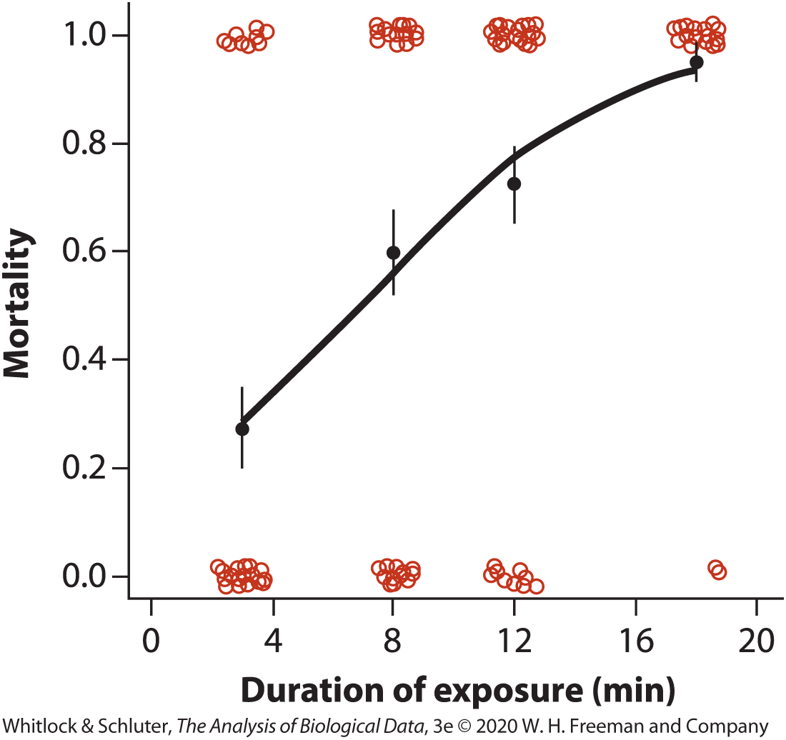
Bernouli GLM (Logistic Regression)
 | Duration of exposure (min): 3 | Duration of exposure (min): 8 | Duration of exposure (min): 12 | Duration of exposure (min): 18
Died (Y = 1) | 11 | 24 | 29 | 38
Survived (Y = 0) | 29 | 16 | 11 | 2
160 guppies exposed, 40 fish per treatment
Log-odds(Y) = a + bX
Notes:
160 guppies exposed to cold temperatures for different durations
40 fish per treatment
Curve shows proportion of fish that die at levels of exposure X

Slide 16
Logistic Regression
Assumes outcomes at x have binomial distribution, instead of normal
Probability of an event (dying) for given x is predicted by curve
 | Estimate | SE
Intercept | −1.66 | 0.41
Slope | 0.24 | 0.04
Model | df | Deviance | Residual df | Residual deviance | P
Null |  |  | 159 | 209.55
Duration | 1 | 44.86 | 158 | 164.69 | 2.12×10⁻¹¹

Slide 17
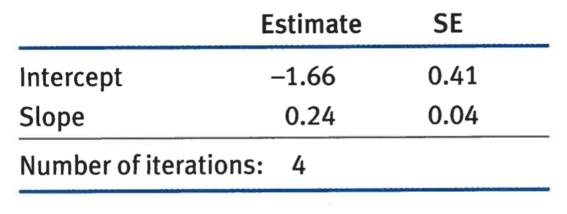
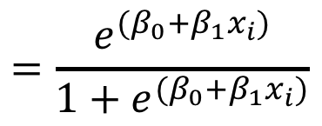
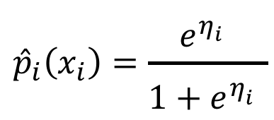
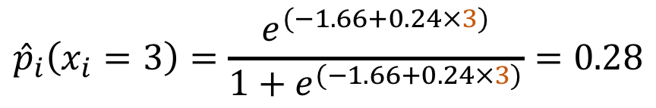
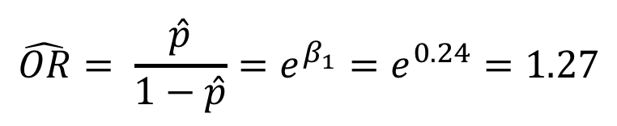
Example: Bernoulli GLM
$$\hat{OR}= \frac{\hat{p}}{1−\hat{p}}=e^{β_{1}}=e^{0.24}=1.27$$
$${\hat{p}}_{i}\left(x_{i}\right)=\frac{e^{η_{i}^{}}}{1+e^{η_{i}^{}}}$$
$$=\frac{e^{(β_{0}+β_{1}x_{i})}}{1+e^{(β_{0}+β_{1}x_{i})}}$$
$${\hat{p}}_{i}\left(x_{i}=3\right)=\frac{e^{(−1.66+0.24×3)}}{1+e^{(−1.66+0.24×3)}}=0.28$$
Notes:
Odds of dying increase by 1.27 for every addition minute of exposure to cold treatment

Slide 18

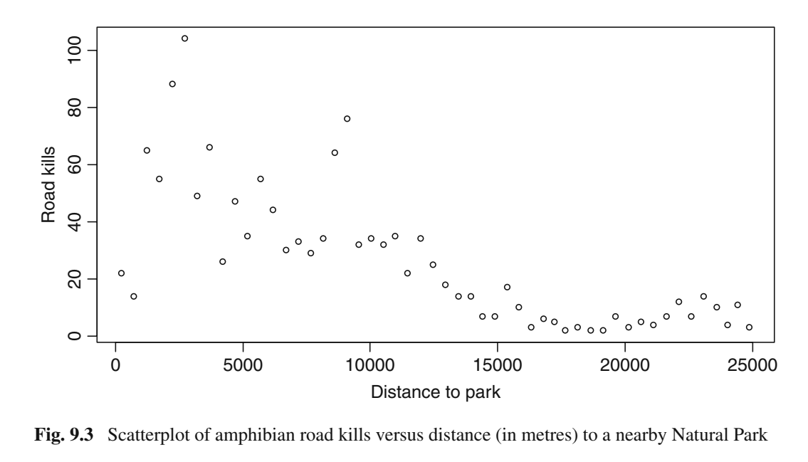
Poisson Regression Example
Notes:
Road kills of amphibians at 52 sites along a road in Portugal
What is the relationship between number of road kills and distance to a park (in meter)?
-non-linear relationship
-variance is greater at higher values of road kills
-data are counts
=poisson glm
Example from Ch. 9. GLM and GAM for Count Data. In Zuur et al. Mixed effects models and extensions in ecology with R.
Photo: Luis Fernández García/Wikipedia.org Iberian Wood Frog

Slide 19
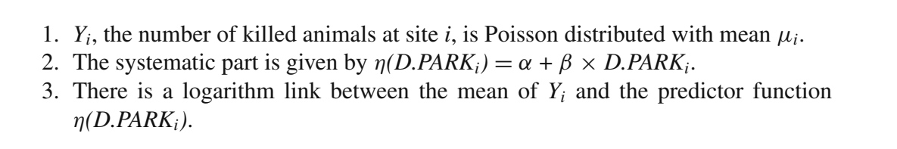
Poisson Regression Example
Response variable (Y_{i}) = number of animals killed at site i is Poisson distributed with mean u_{i}

Slide 20
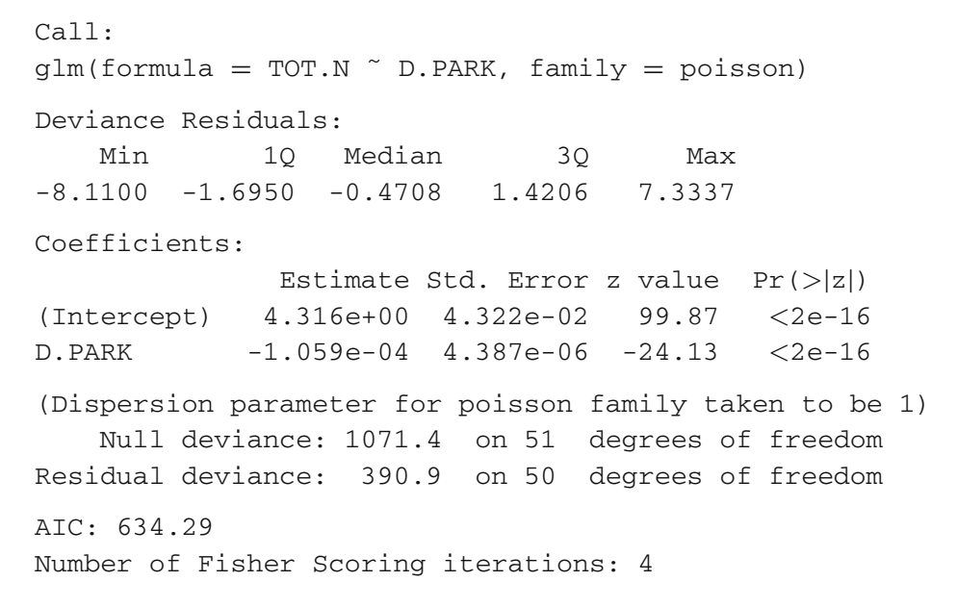
Poisson Regression Example

Slide 21
Poisson Regression Example
Notes:
Coefficient interpretation: The log number of individuals killed on roads decreases by 1.059e-04 for every meter (0.1059/km) in greater distance from the park

Slide 22
Poisson Regression Example
Notes:
What’s different here is the null and residual deviance
These are equivalents to the total sum of squares and the residual sum of squares, respectively

Slide 23
Poisson Regression Example
Null Deviance: residual deviance in the model that only contains the intercept (worst possible model)
Equivalent to total sums of squares in linear model
Residual Deviance: twice the difference between the log likelihood of a model that provides a perfect fit (saturated model) and the log likelihood for the model under study
Notes:
Null deviance is the residual deviance in the model that only contains the intercept (i.e., worst possible model)
Residual deviance is twice the difference between the log likelihood of a model that provides a perfect fit (saturated model) and the log likelihood for the model under study

Slide 24
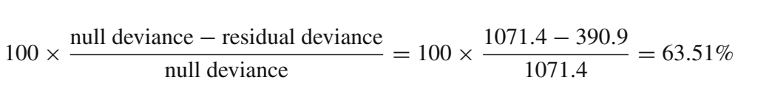
Poisson Regression Example
Pseudo R-squared
Distance to park explains 63.51% of the variation in road kills
Notes:
Pseudo r-squared

Slide 25
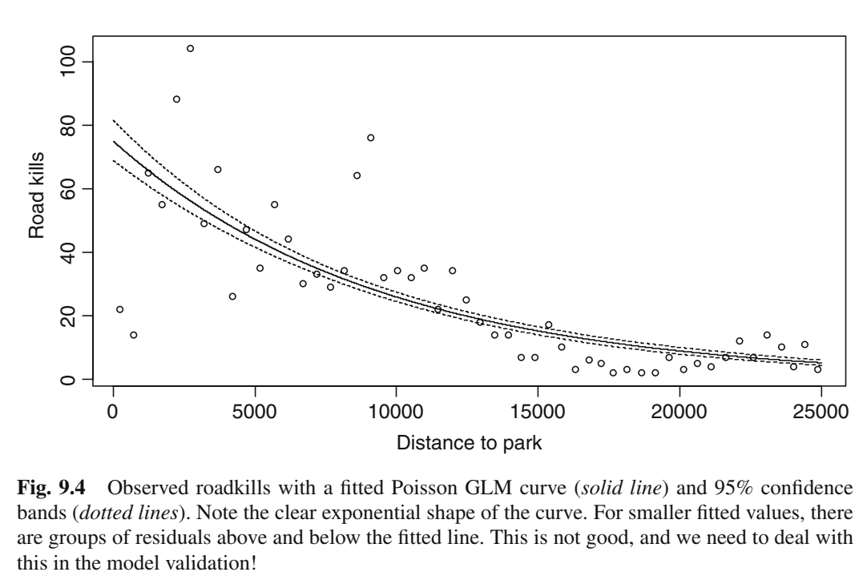
Poisson Regression Example
Notes:
Can use model calculated above to generate an exponential curve and confidence intervals around the line by predicting values of Y using the regression equation
Problem: patterns in the data for smaller fitted values (waves or points above and below)
Indicates a problem with the model

Slide 26
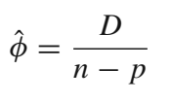
Checking for Overdispersion
390.9/51 = 7.65
Notes:
Phi (fee) is dispersion
Overdispersion = variance larger than the mean
Can test for overdispersion by looking at the ratio of the residual deviance (D) to n-p (number of samples – number of parameters)
In this case, ratio >1, so there is evidence of overdispersion

Slide 27
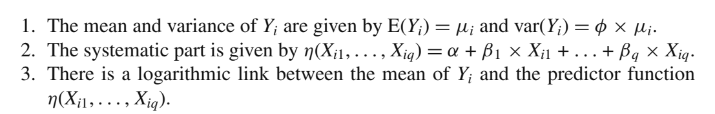
Quasi-Poisson Model for Over-dispersed data
Notes:
Similar to the poisson model, but no longer specify a Poisson distribution
Allows us to apply a scaling factor (phi) to the variance

Slide 28
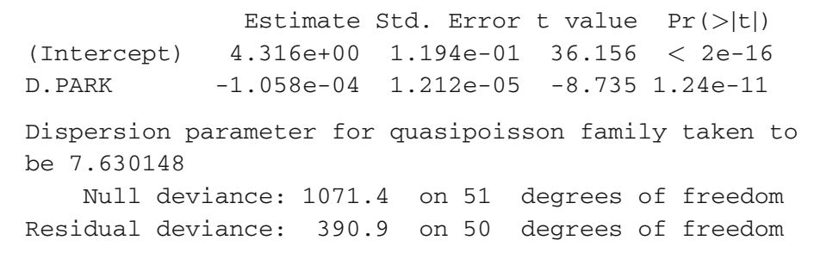
Quasi-Poisson Model for Over-dispersed data
Notes:
Similar to the poisson model, but no longer specify a Poisson distribution
Allows us to apply a scaling factor (phi) to the variance

Slide 29
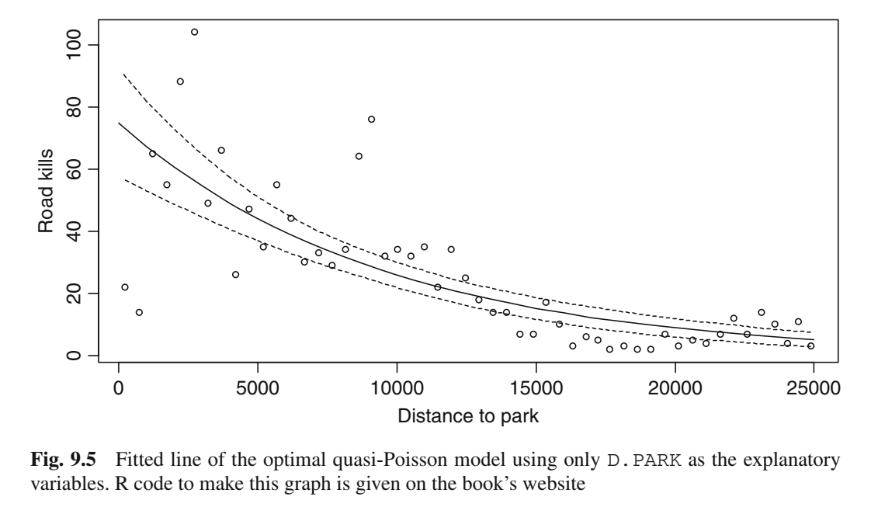
Quasi-Poisson Model for Over-dispersed data
Notes:
Quasi-poisson model gives similar curve, but confidence intervals are wider due to overdispersion correction
Looks like there are still some patterns in the curve…we will now look at plots of residuals to double check

Slide 30
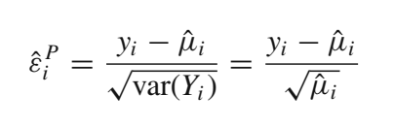
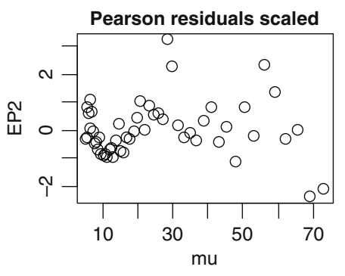
Checking Model Assumptions
Pearson Residuals
Notes:
Similar to linear models, need to look at the residuals
-use a square root transformation, which accounts for having larger variance associated with larger values of Y
-plot of residuals (EP2) versus predicted values (mu) shows there are patterns

Slide 31
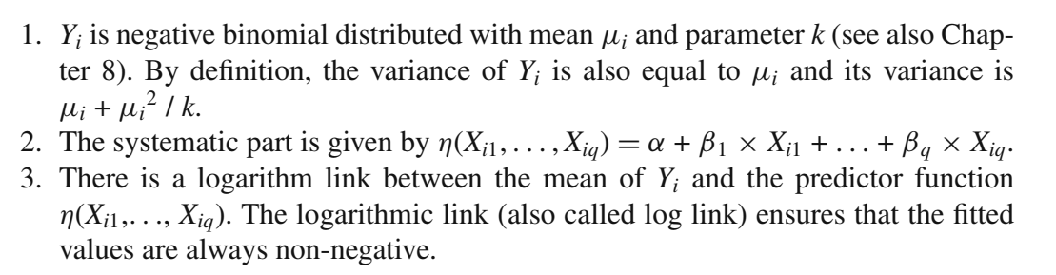
Negative Binomial Model

Slide 32
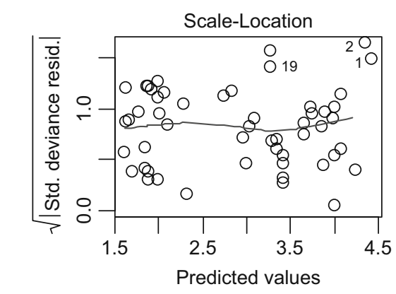
Negative Binomial Model

Slide 33
Summary
Generalized linear models accommodate non-normal error structures
Logistic regression is useful when you are predicting a binary outcome from a set of continuous predictor variables.
Poisson regression is useful when predicting an outcome variable representing counts from a set of continuous predictor variables.
Generalized linear models require that the variance function and dispersion parameter be correctly specified

